Slide 1
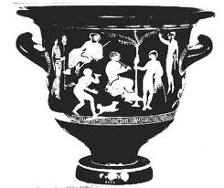
_
X
Wednesday, October 26
_
_
X
_
_
X
_
_
_
X
X
X
_
_
_
X
X
_
X
X
X
_
_
_
X
_
_
X
X
X
_
_
X
X
_
_
X
X
_
_
X
X
_
_
_
X
X
_
X
_
X
X
_
X
_
X
_
_
X
_
X
_
X
X
X
_
X
_
X
X
μ

Slide 3
Central Limit Theorem
The sampling distribution of means from random samples
of n observations approaches a normal distribution
regardless of the shape of the parent population.
Just for fun, go check out the Khan Academy
http://www.khanacademy.org/video/central-limit-theorem?playlist=Statistics

Slide 4
Wow! We can use the z-distribution to test a hypothesis.
_
X - μ
z =
-
σ_{X}

Slide 5
Step 1. State the statistical hypothesis H₀ to be tested (e.g., H₀: μ = 100)
Step 2. Specify the degree of risk of a type-I error, that is, the risk of incorrectly concluding
that H₀ is false when it is true. This risk, stated as a probability, is denoted by α, the probability
of a Type I error.
Step 3. Assuming H₀ to be correct, find the probability of obtaining a sample mean that
differs from μ by an amount as large or larger than what was observed.
Step 4. Make a decision regarding H₀, whether to reject or not to reject it.

Slide 6
An Example
You draw a sample of 25 adopted children. You are interested in whether they
are different from the general population on an IQ test (μ = 100, σ = 15).
The mean from your sample is 108. What is the null hypothesis?

Slide 7
An Example
You draw a sample of 25 adopted children. You are interested in whether they
are different from the general population on an IQ test (μ = 100, σ = 15).
The mean from your sample is 108. What is the null hypothesis?
H₀: μ = 100

Slide 8
An Example
You draw a sample of 25 adopted children. You are interested in whether they
are different from the general population on an IQ test (μ = 100, σ = 15).
The mean from your sample is 108. What is the null hypothesis?
H₀: μ = 100
Test this hypothesis at α = .05

Slide 9
An Example
You draw a sample of 25 adopted children. You are interested in whether they
are different from the general population on an IQ test (μ = 100, σ = 15).
The mean from your sample is 108. What is the null hypothesis?
H₀: μ = 100
Test this hypothesis at α = .05
Step 3. Assuming H₀ to be correct, find the probability of obtaining a sample mean that
differs from μ by an amount as large or larger than what was observed.
Step 4. Make a decision regarding H₀, whether to reject or not to reject it.

Slide 10
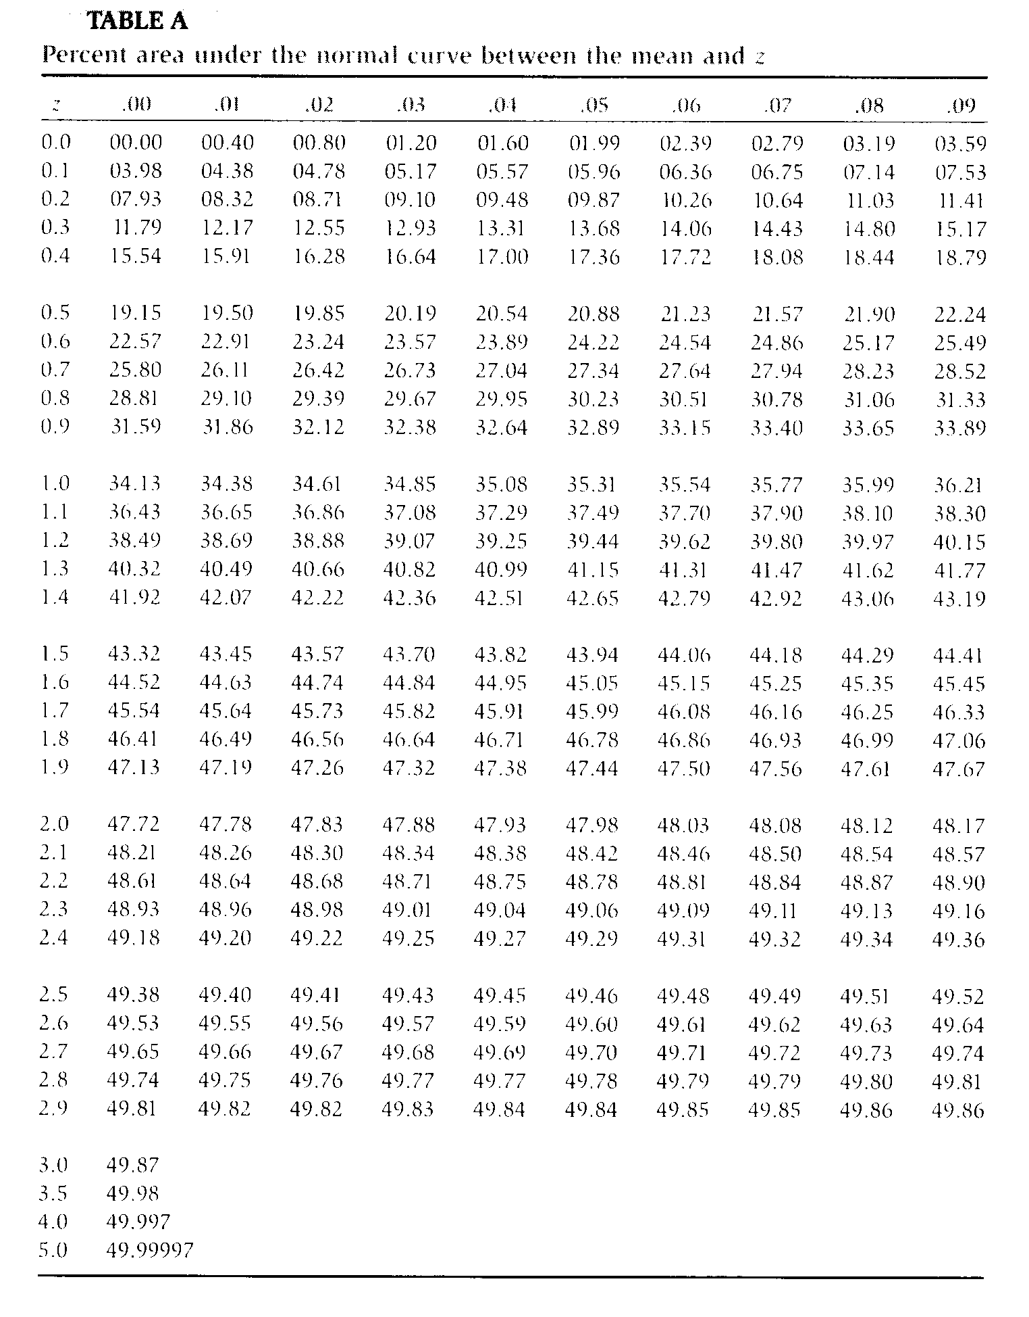

Slide 11


Slide 12
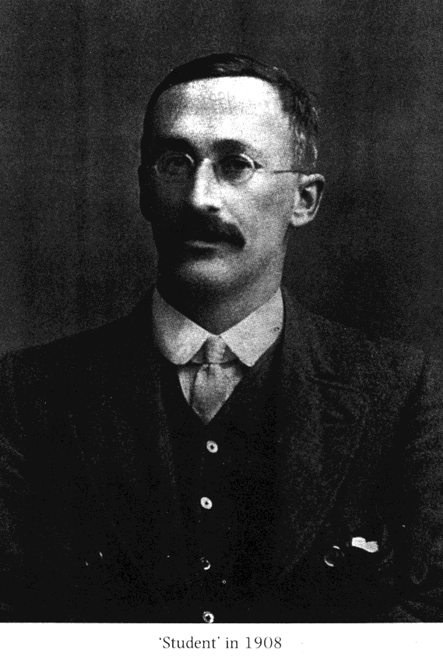
GOSSET, William Sealy 1876-1937

Slide 13


GOSSET, William Sealy 1876-1937

Slide 14
The t-distribution is a family of distributions varying by degrees of freedom (d.f., where
d.f.=n-1). At d.f. = ∞, but at smaller than that, the tails are fatter.

Slide 15
_
X - μ
z =
-
σ_{X}
_
X - μ
t =
-
s_{X}
s
-
s_{X} =
√ N

Slide 16
The t-distribution is a family of distributions varying by degrees of freedom (d.f., where
d.f.=n-1). At d.f. = ∞, but at smaller than that, the tails are fatter.

Slide 17
Degrees of Freedom
df = N - 1

Slide 18
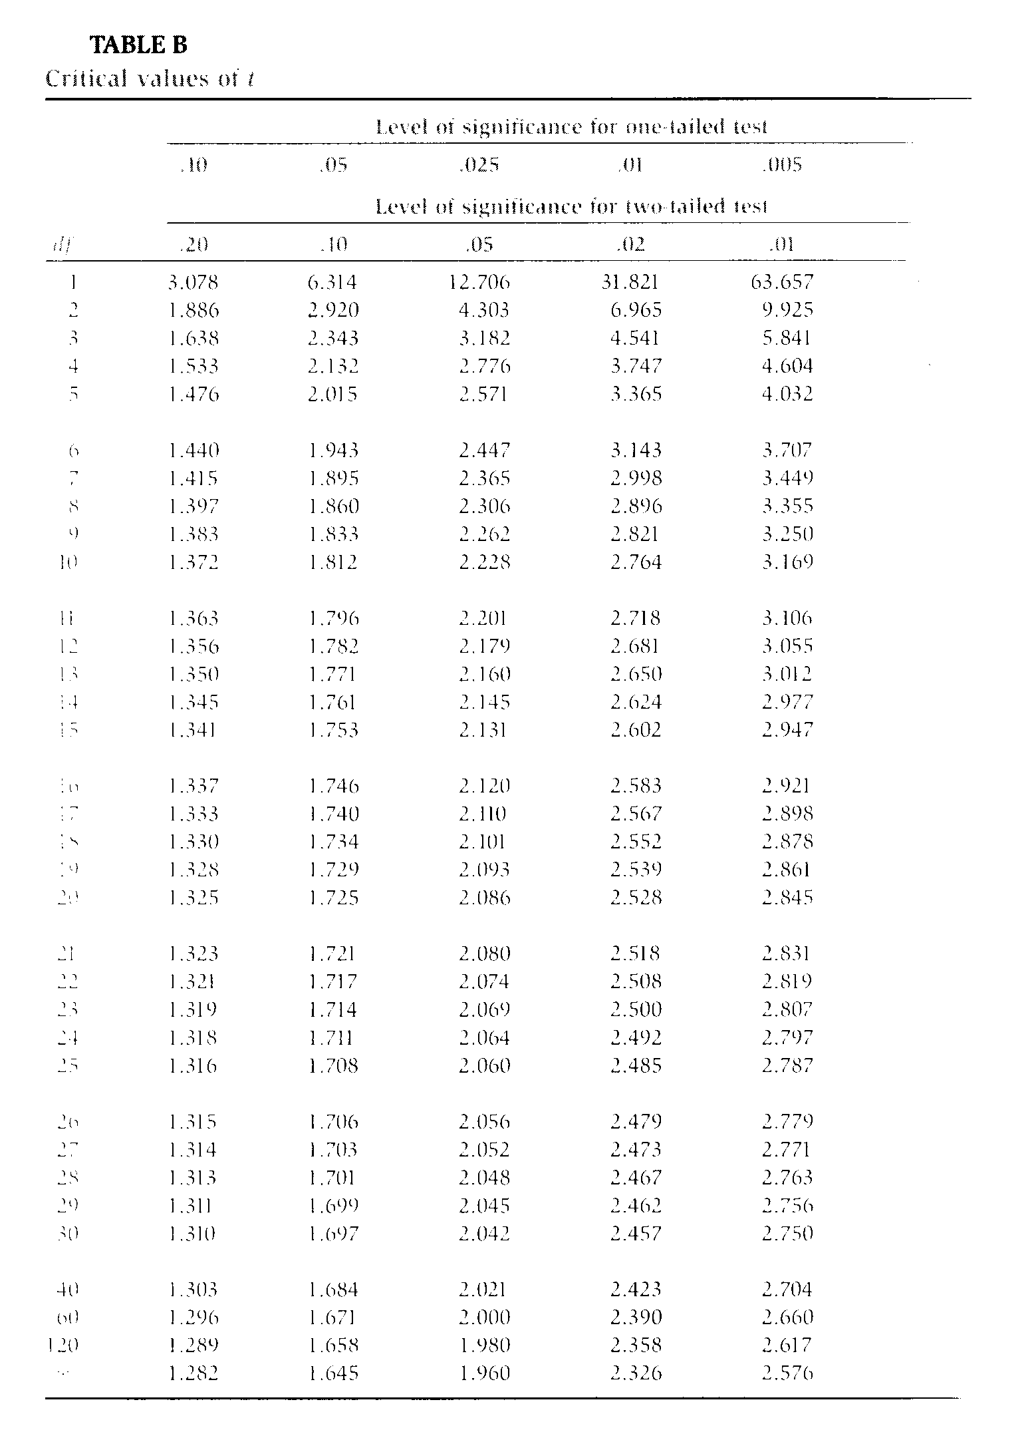

Slide 19
Problem
Sample:
Mean = 54.2
SD = 2.4
N = 16
Do you think that this sample could have been drawn from a population with μ = 50?

Slide 20
Problem
Sample:
Mean = 54.2
SD = 2.4
N = 16
Do you think that this sample could have been drawn from a population with μ = 50?
_
X - μ
t =
-
s_{X}

Slide 21
The mean for the sample of 54.2 (sd = 2.4) was significantly different from a hypothesized population mean of 50, t(15) = 7.0, p < .001.

Slide 22
The mean for the sample of 54.2 (sd = 2.4) was significantly reliably different from a hypothesized population mean of 50, t(15) = 7.0, p < .001.

